Slide 1
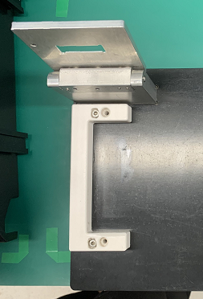
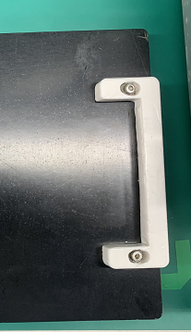
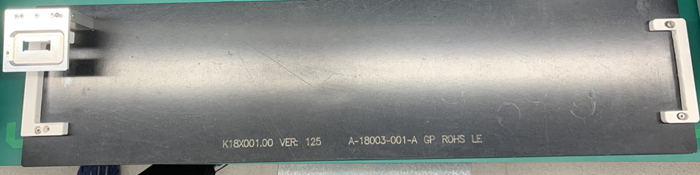
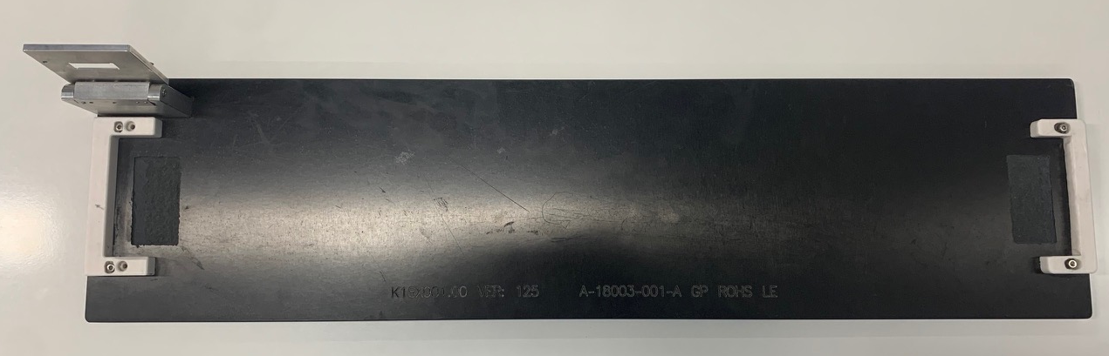
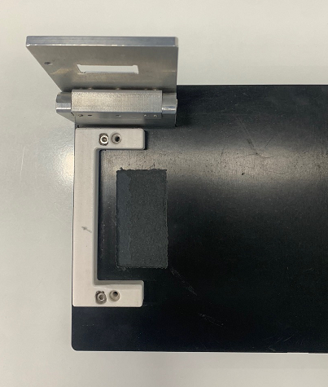
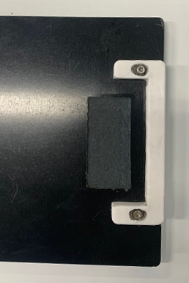
K18X001.00 Report improve fixture
Description issue:
On 2023/03/02 Customer feedback improve cut the SKB badge area on the fixture at the RC2 station.
Improve :
The ME engineer corrects the surface of the fixed fixture to prevent abnormalities from causing scratches on the outside of the product （Done）
Update new picture fixture in the SOP (Done)
Status | Picture overview | Left fixture | Right Fixture
Before improve
After improve

Slide 2
K18X001.00 Report improve fixture
Before
After

